Slide 1
Chapter 5
Supervised Deep Learning for Secure Internet of Things

Slide 2

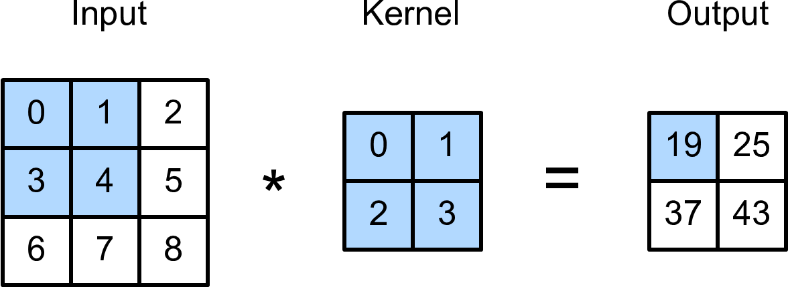
Convolutional Neural Network

Slide 3
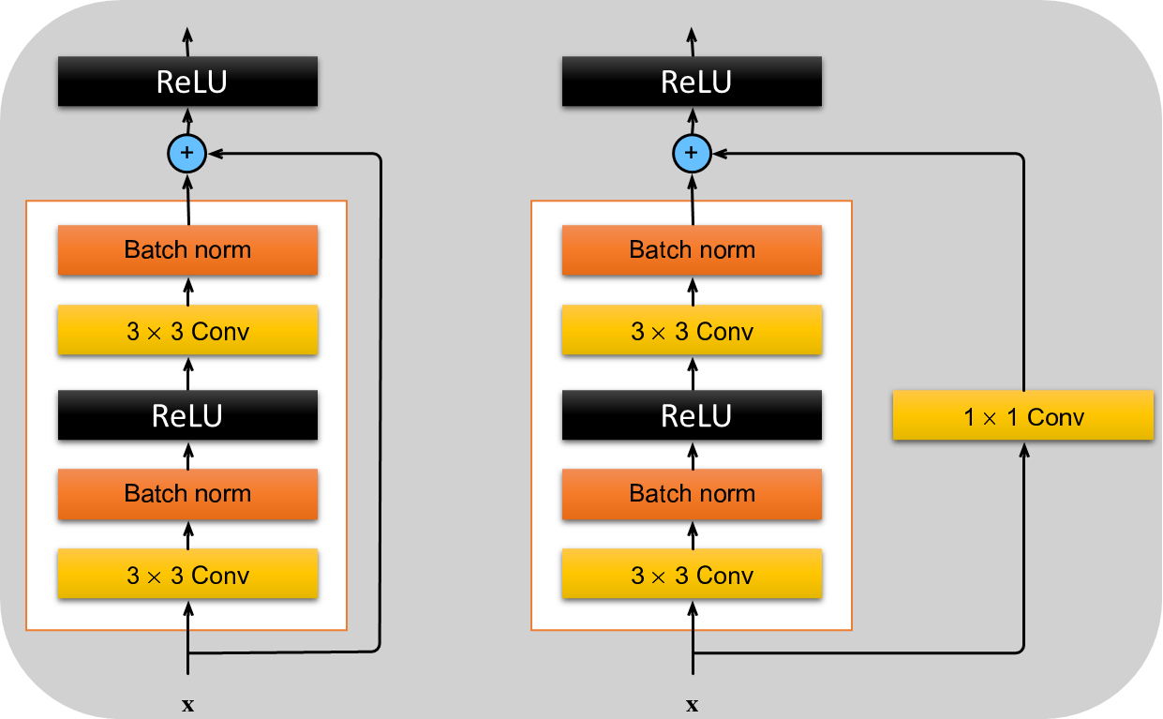
Advanced Convolutional Neural Network

Slide 4
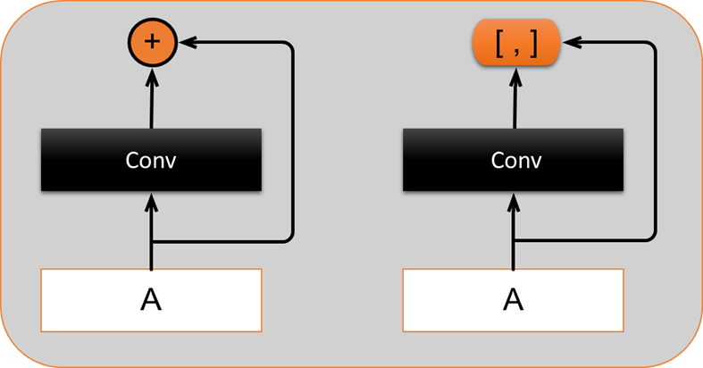
Advanced Convolutional Neural Network

Slide 5
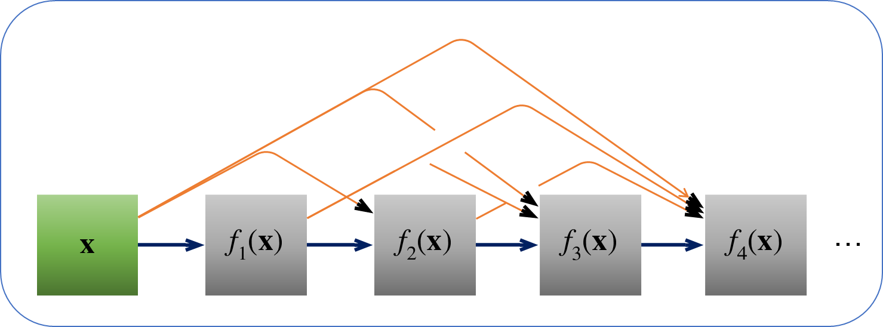
Advanced Convolutional Neural Network

Slide 6
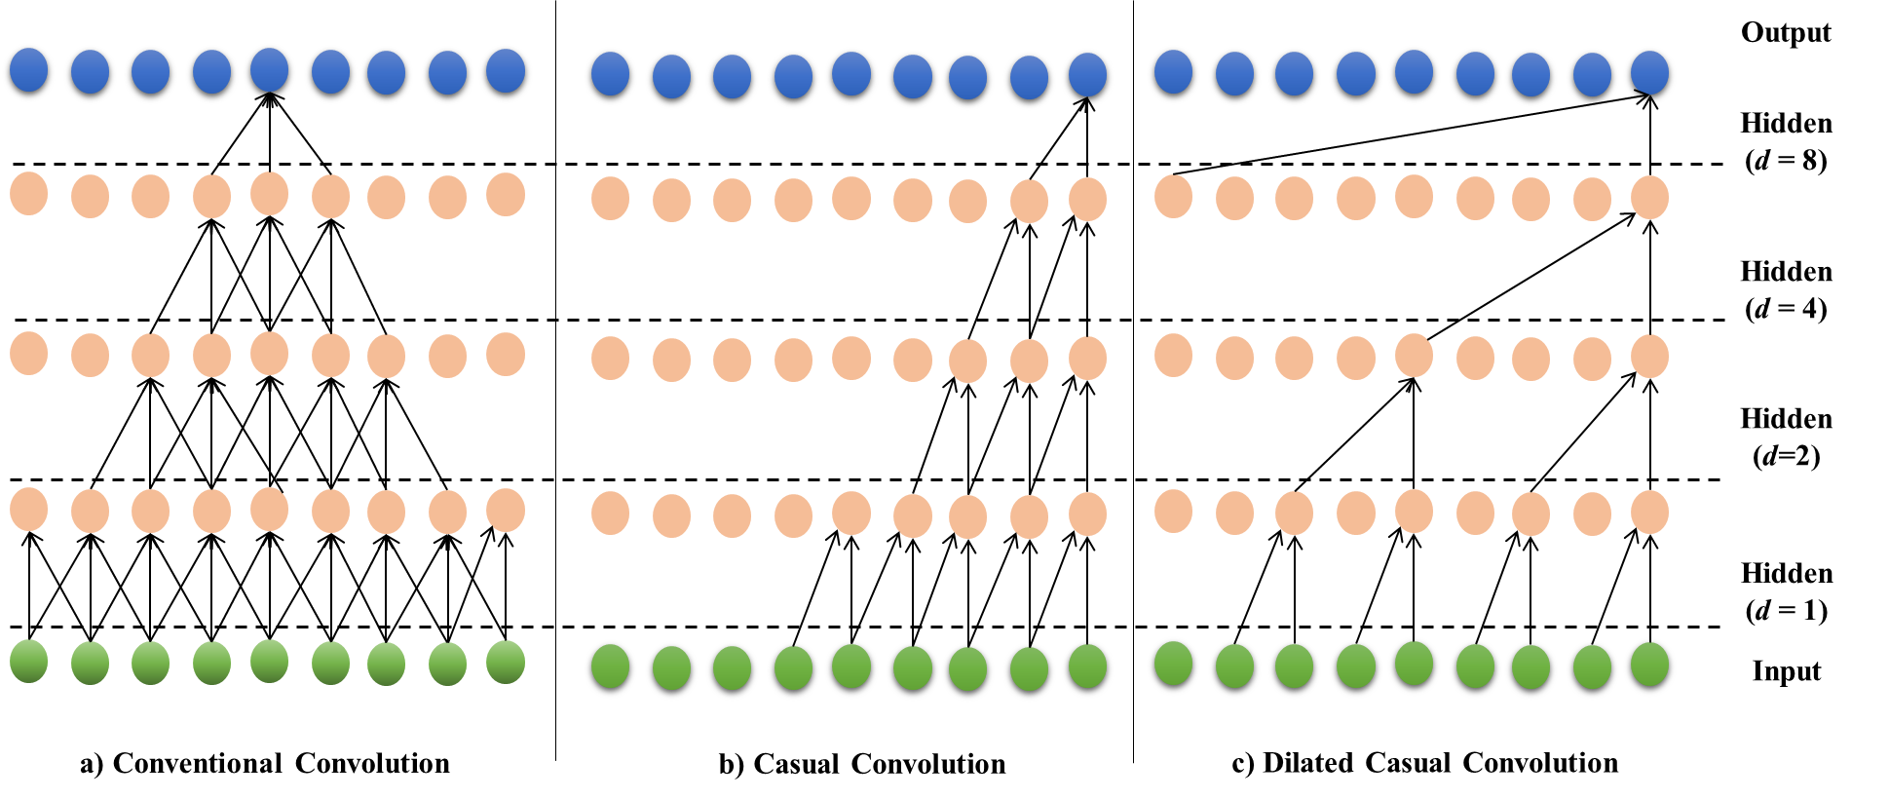
Temporal Convolutional Neural Network

Slide 7
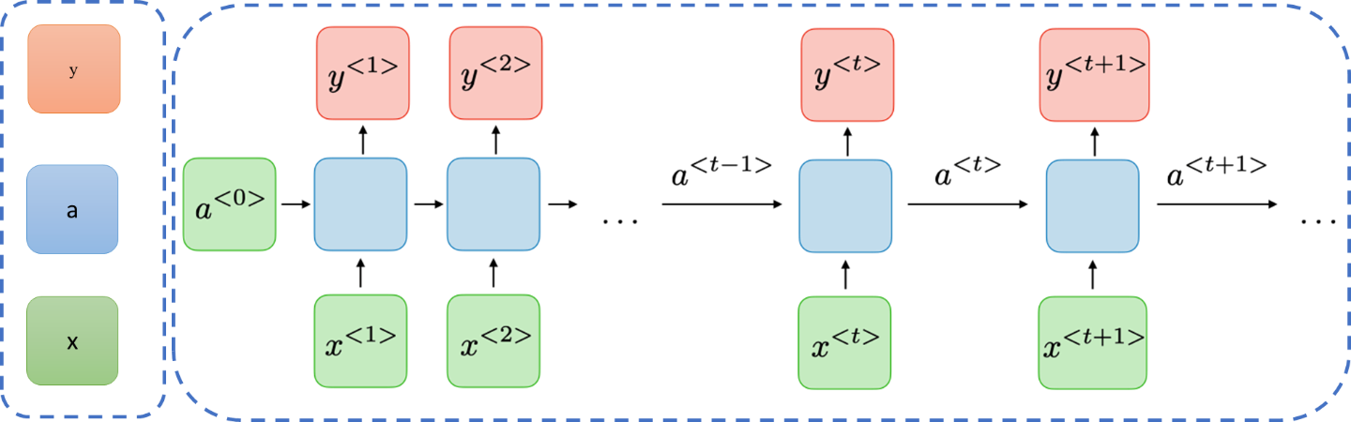
Recurrent Neural Networks

Slide 8
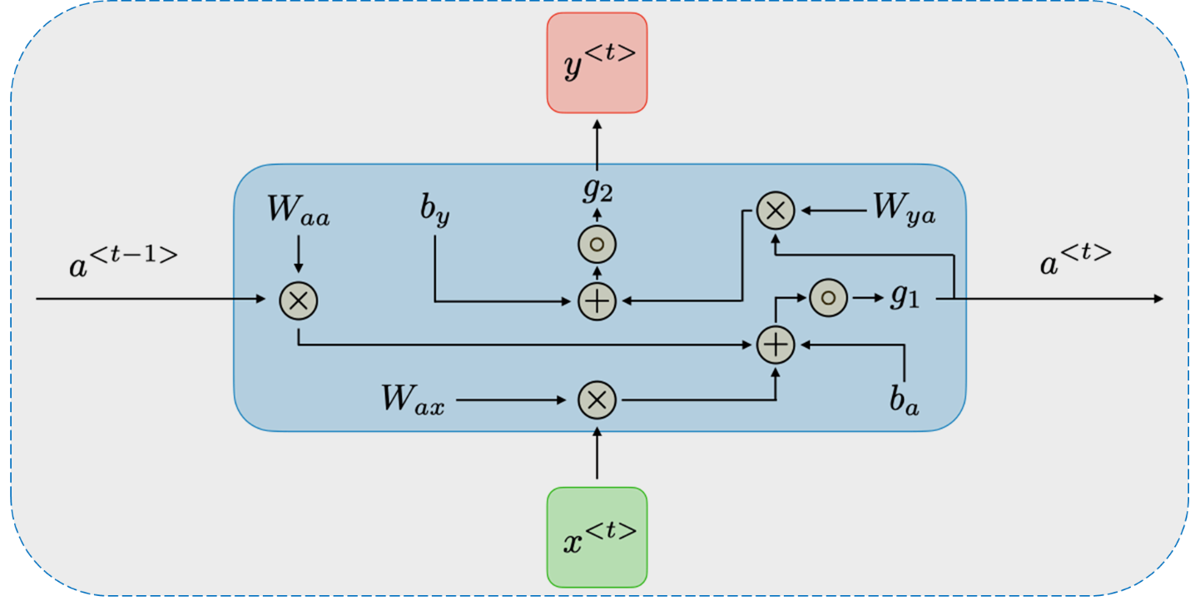
Recurrent Neural Networks

Slide 9
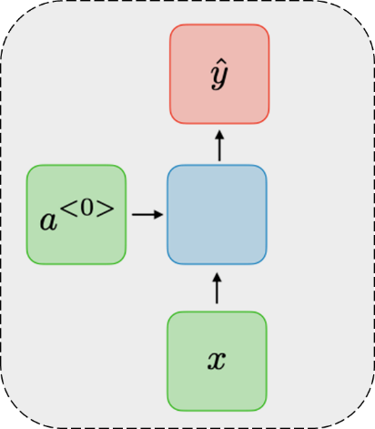
Recurrent Neural Networks

Slide 10
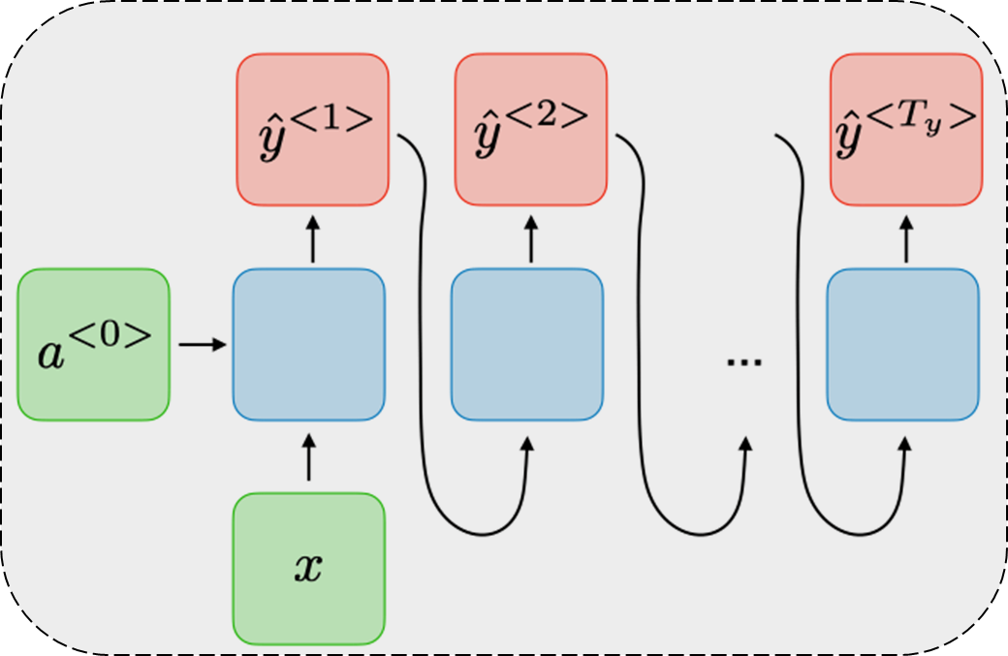
Recurrent Neural Networks

Slide 11
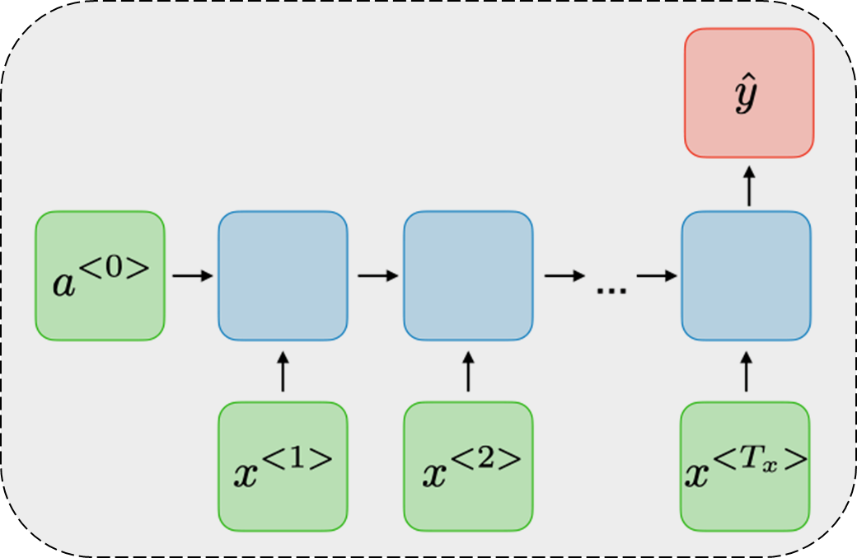
Recurrent Neural Networks

Slide 12
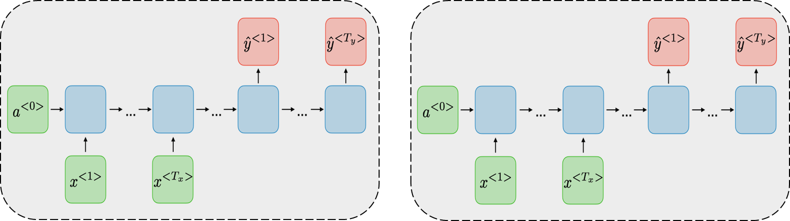
Recurrent Neural Networks

Slide 13
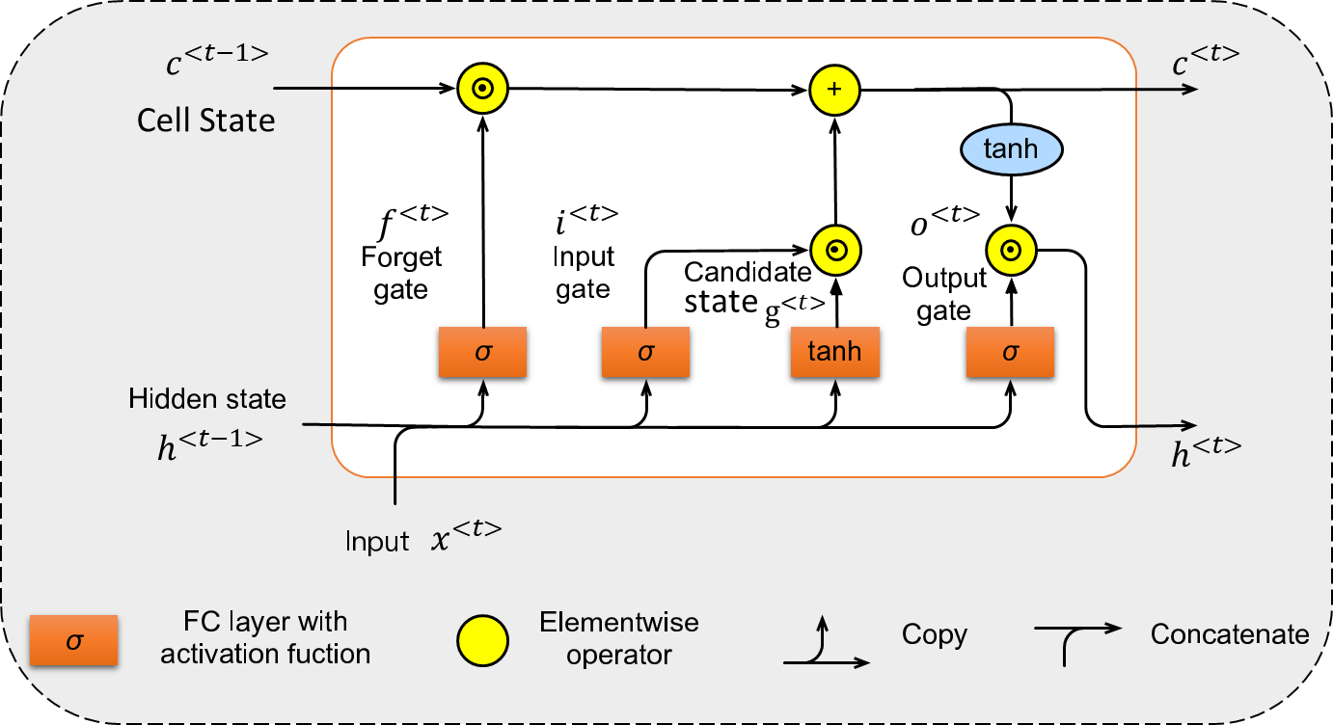
Recurrent Neural Networks

Slide 14
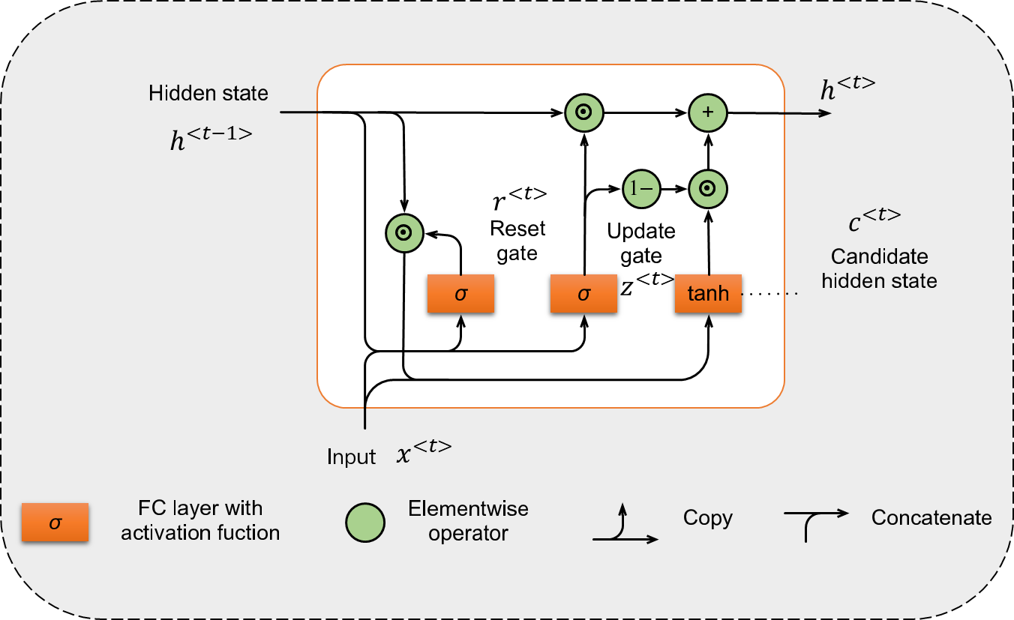
Recurrent Neural Networks

Slide 15
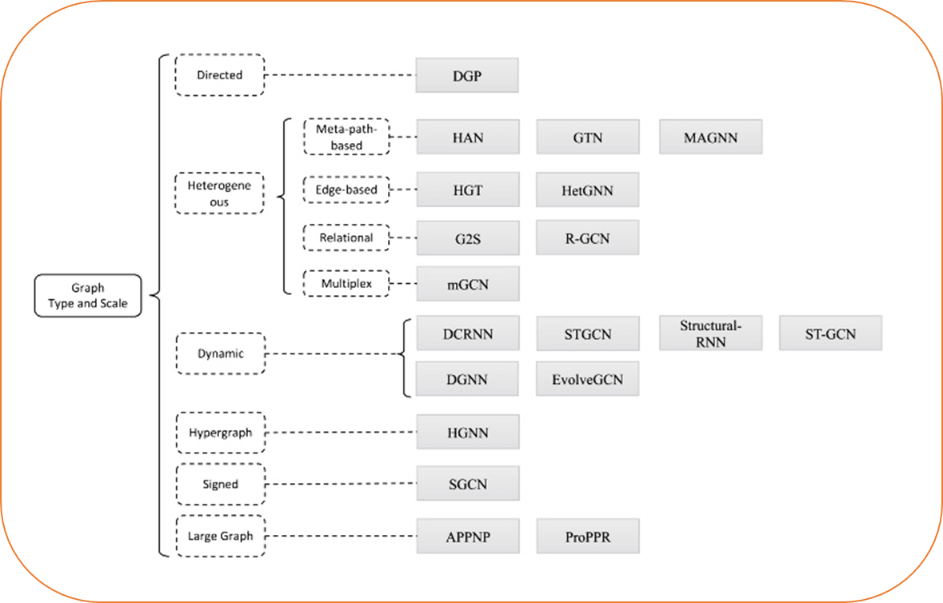
Graph Neural Networks

Slide 16
Supervised Datasets and Evaluation measures
KDD Cup99 Dataset
NSL-KDD Dataset
UNSW-NB15 Dataset
UGR’16 Dataset
DDoS 2016 Dataset
CICIDS 2017 Dataset

Slide 17
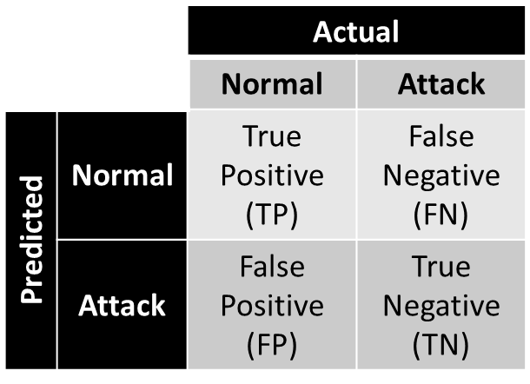
Supervised Datasets and Evaluation measures

Slide 18
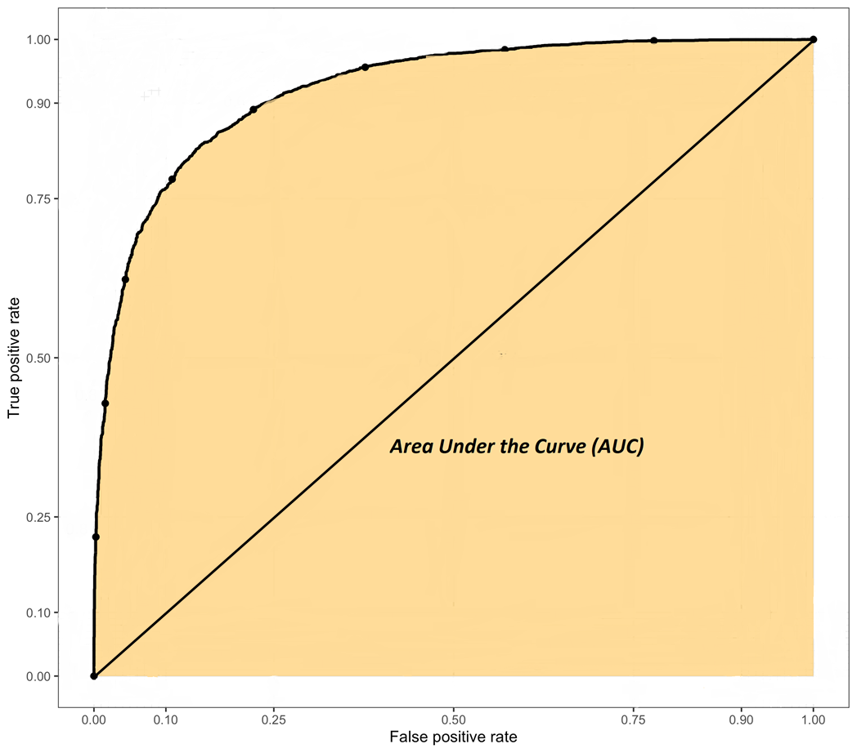
Supervised Datasets and Evaluation measures

Slide 19
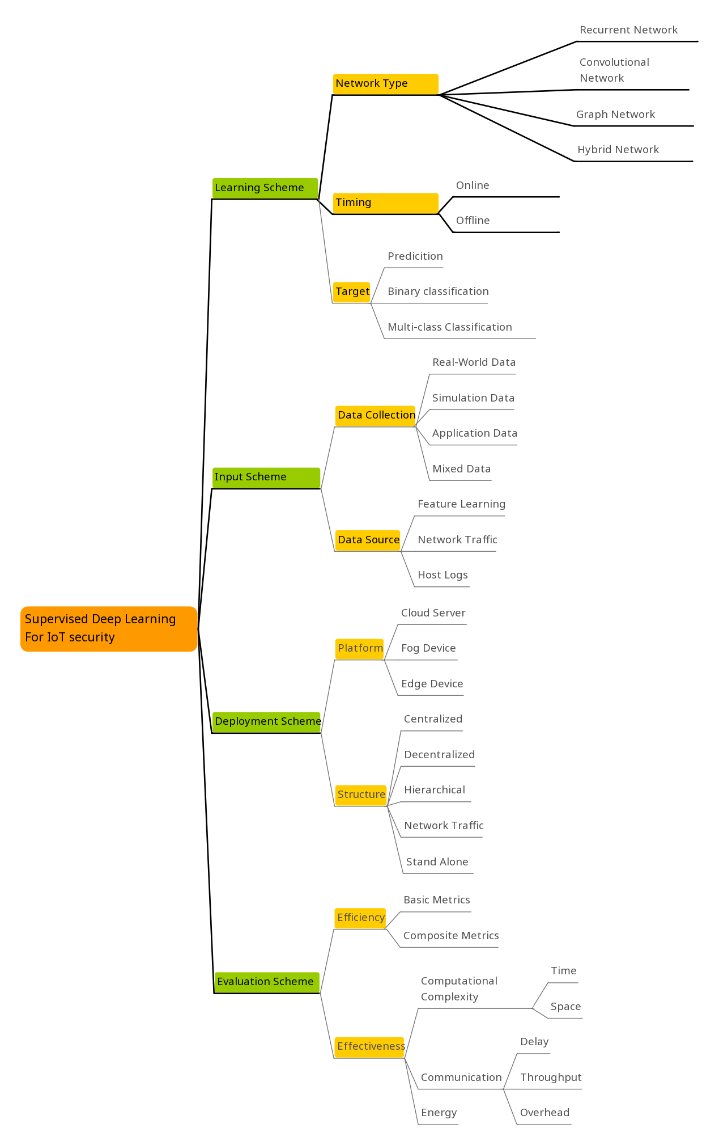
Taxonomy of Deep Learning solutions for IoT

